Slide 1
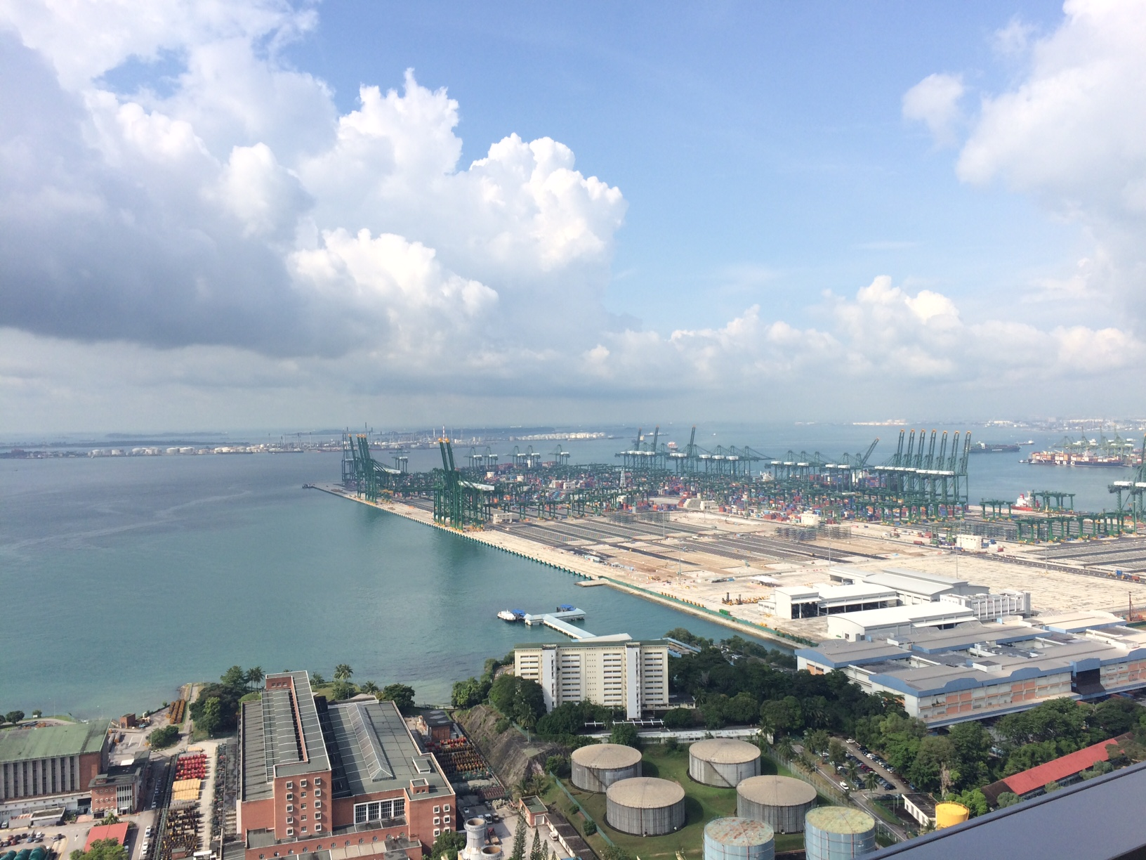
The Evolution of Shipping and Maritime Industries in Singapore
GES1009. Week 5(II)
Dr. Brunero

Slide 2
Lecture Outline
Shipping and maritime industries, general characteristics
Case studies:
Lighters and the Singapore River
The Peninsular and Orient Shipping Company (P&O), Blue Funnell Line, The Straits Steamship Company Malaya
Post 1960s: Neptune Orient Line and containerisation

Slide 3
Shipping Companies and business history
Often cited as displaying ‘modern’ business practices
An example of ‘transformative’ technologies and the role they play in transforming economies and also business practices.
Provides the opportunity to study business networks, through the global movements of people and goods.

Slide 4
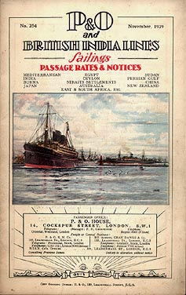
Oceanic Shipping
Large firms
Frequently appointed representatives in ports
Able to develop an administrative structure for business
Could draw on a pool of ship masters
Vertical integration but also a tendency for horizontal integration

Slide 5
Coastal shipping
Generally smaller firms
All owners sharing in the vessels
Company managed by a single investor
Catering to regional demands.
LINERS vs TRAMPS

Slide 6
Case Studies: Lighters and the SG River
Lighterage: one of the first major industries to develop in Singapore.
Handling cargo from larger ships and bringing them to the riverfront
1819-1900 Indian lighters (South Indian boatmen) dominated the river. By 1860, estimated at 1500 lightermen.

Slide 7
New Harbour and the demise of Indian boatmen.
European traders & shipping gravitated towards the New Harbour area. European godowns on the River were replaced by Chinese businesses.
Steamships and modern wharves made the lighters less important.
The industry remained focused on the SG River and passed gradually into Chinese hands. (tensions and competition)

Slide 8
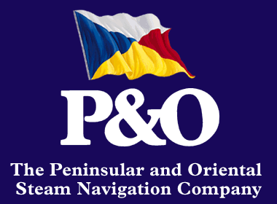
Peninsular and Oriental Steam Navigation Company (P&O)
Established in 1835 as a partnership between Brodie Willcox, Arthur Anderson and Richard Bourne.
Successive mail contracts then expanded to a passenger service. Merger with the Transatlantic Steam Navigation Co. and became the Peninsular and Orient Steam Navigation Co by Royal Charter of 1840
Strategies?
Investing in larger ships, coaling stations and infrastructure.
1842: Southampton to Egypt, then India.
Expanding to: Ceylon, Penang, Singapore, Hong Kong by 1845

Slide 9


Slide 10
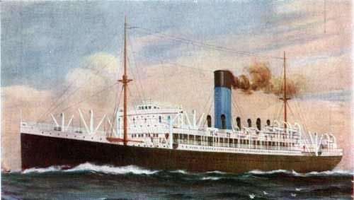
Blue Funnel Line (Holt & Co)
Liverpool based company.
Passenger service from the UK to South Africa, Asia, Australia…
Tapped into other steamer networks for regional travel.
Hajj pilgrims.

Slide 11
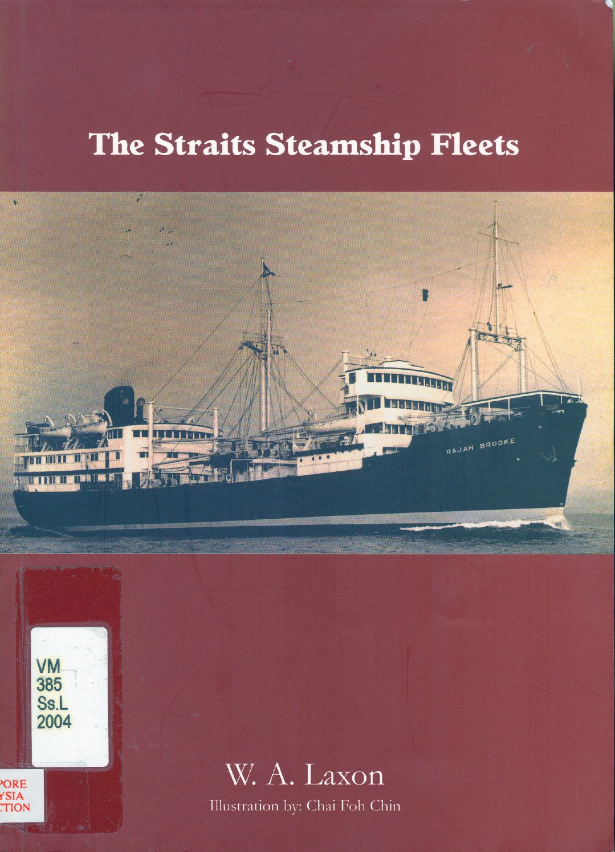
The Straits Steamship Company
Registered in Singapore
Formed as a joint enterprise
Straits Chinese and European financiers, all holding positions on the board of the company

Slide 12
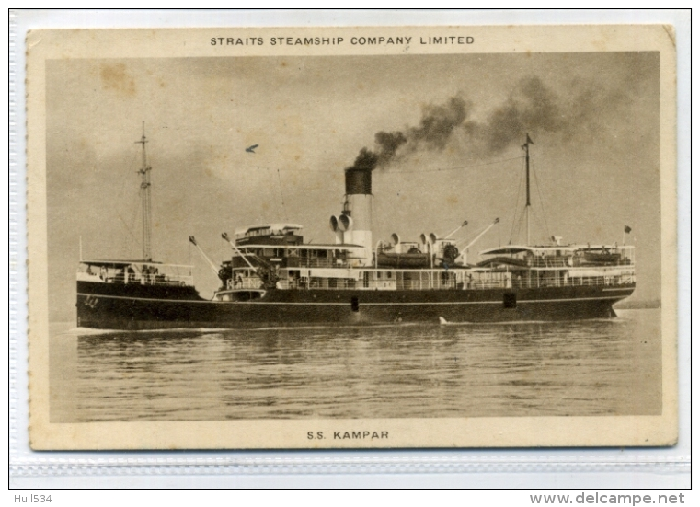
Transporting tin, rubber, raw materials from West Malaysian coast to Singapore.
Dominated the passenger service between Singapore and Malaysian ports
Fierce competition with other steamship companies including:
Wee Bin & Company of Singapore
East Asiatic Company
Siam Steam Navigation Company
Ho Hong Steamship Company

Slide 13
The Straits Steamship Co 1920-1960s…
Took over various steamship lines
Invested in Malayan Air venture (this eventually became SIA)
By post war years, The Straits Steamship Company was the focus of mergers/acquisitions and was absorbed into Keppel Corporation.

Slide 14
Cartels and Conferences
Increasingly common in the era of steam (c.1850s onwards!).
Tended to be organized by big companies: Liners
Conferences (and cartels) to fix freight rates or passenger fares and to enforce these rates on members.
New entrants? Subjected to price wars, exclusive contracts, predatory behaviours
Shipping companies? Argued that conferences and cartels were important to stop monopolies from developing and to regulate the industry… (do you agree?)
Govt regulations and efforts to curb cartels c. 1960s onwards.

Slide 15
The Asian Maritime World: the War Years and beyond
Shipping industry in tatters; politics at the forefront.
Rise of Asian shipping/redevelopment of Asian ports.
Japan took a leading role in the region.
1960s containerization and the TRANSFORMATION of shipping practices.

Slide 16
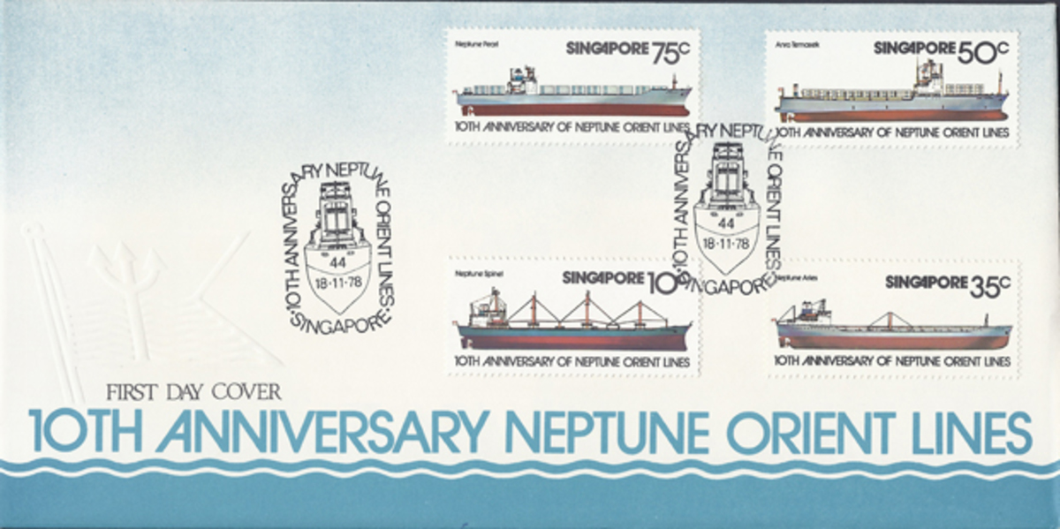
Neptune Orient Lines
1968: a national shipping line. (Neptune Topaz and Neptune Zircon)
Only became profitable c1975:
Shifted to containerization and revamped its fleet
Made innovations regarding cargos and operation methods

Slide 17

Neptune Orient Lines
Listed on the Stock Exchange in 1981.
1986: global slump/disruption to shipping
1980s: diversification into: liner, bulker, tanker, also logistics, management and marine services
1990s-2000s: volatility in shipping, NOL swings between profits, acquisitions and losses.
In 2015, Temasek announced its decision to sell its entire stake in NOL to France’s CMA CGM the third biggest global containershipping company.

Slide 18

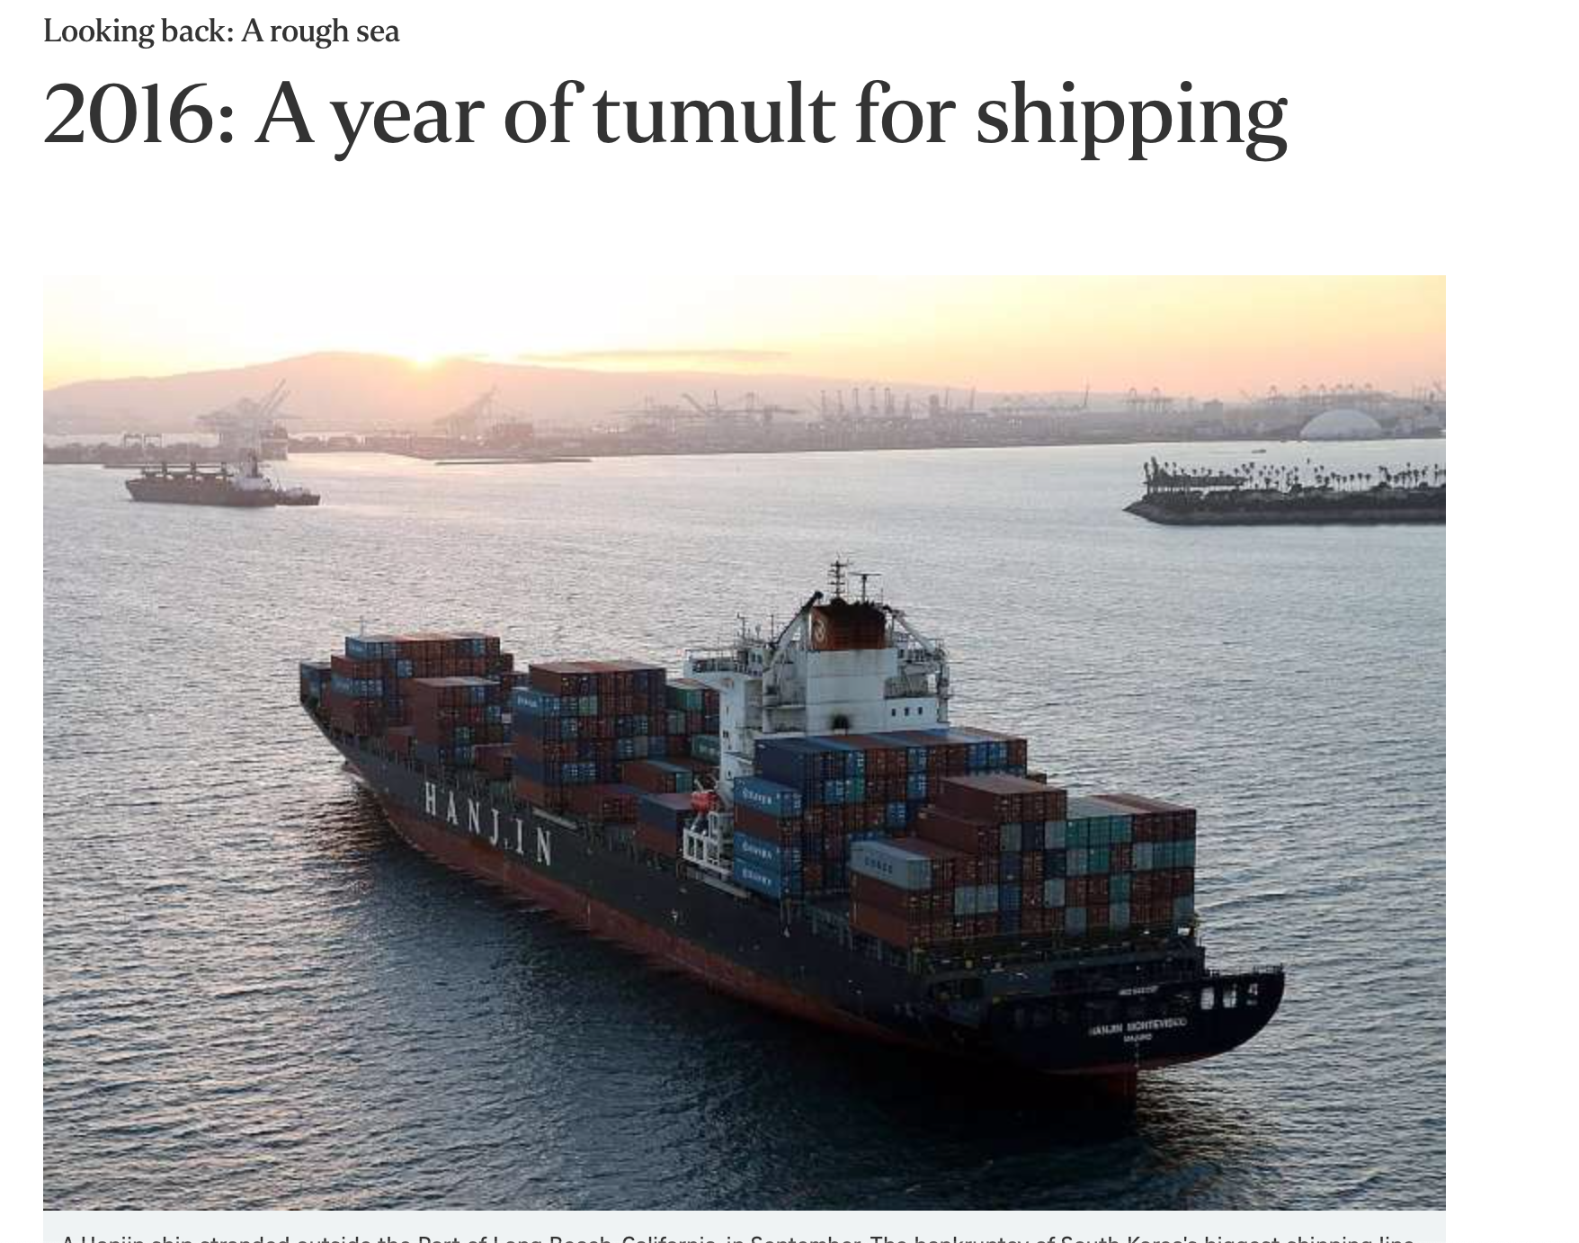

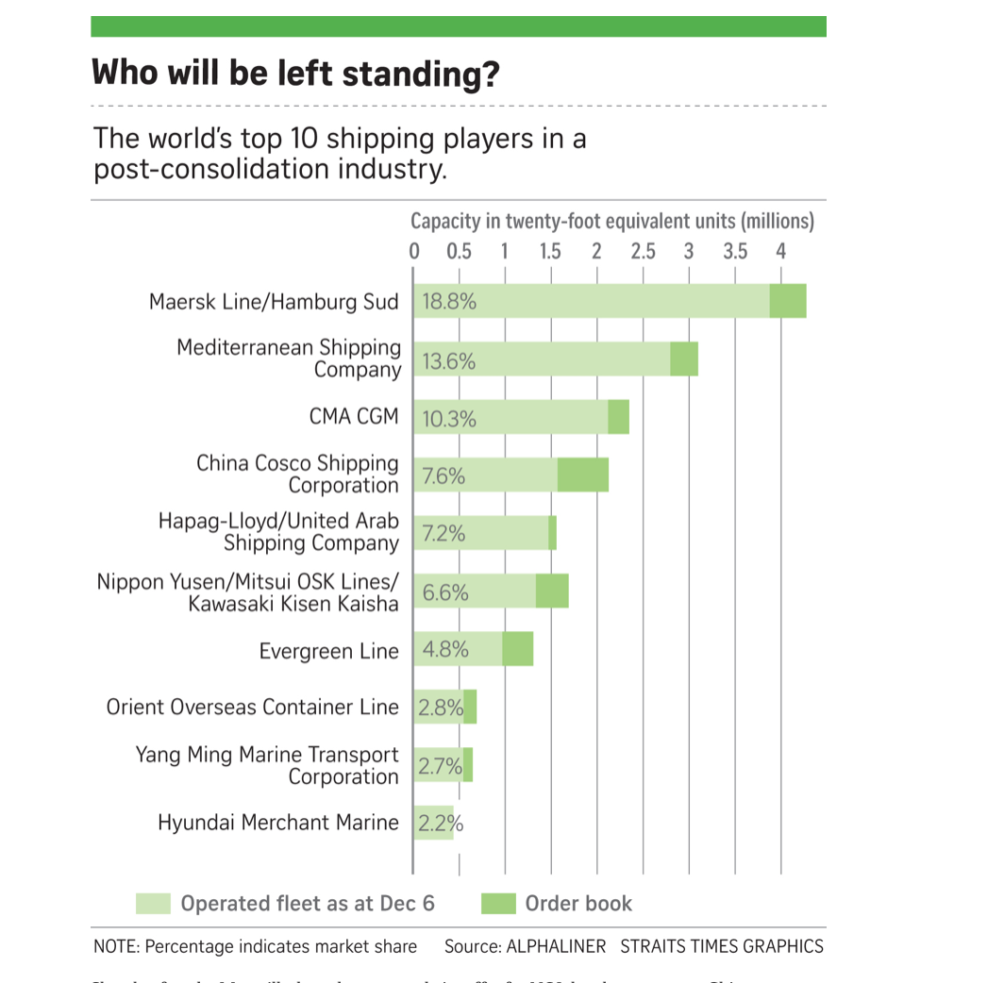

The shipping industry?
Source: The Straits Times, 20 December 2016.
Still facing global uncertainty.
The collapse of Hanjin Shipping Company hit not only the shipping industry but PORTS.
Singapore remains a world-class container port and base of operations for many international shipping lines.

Slide 19
CONCLUSION
From the 1800s to the present, international and coastal shipping industries underwent changes to their business practices/strategies as a result of evolving trade demands and new technologies.
Asian and European firms had interest in shipping in the region and in Singapore as a port, base for ship building and related services: this remains the case in the present day.
Containerization continues to change the shipping industry and to transform Singapore’s role in this industry.

